Slide 1
Object-Oriented Programming
TOPIC 9

Slide 2
CONTENTS
9.1 Procedural and Object-Oriented Programming Defining Classes:
9.2 Classes
9.3Instances

Slide 3
9.1 Procedural and Object-Oriented
Programming Defining Classes:
Procedural programming is a method of writing software. It is a programming practice centered on the procedures or actions that take place in a program. Object-oriented programming is centered on objects. Objects are created from abstract data types that encapsulate data and functions together.

Slide 4
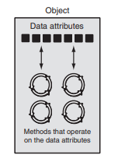
OOP addresses the problem of code and data separation through encapsulation and data hiding.
Encapsulation refers to the combining of data and code into a single object.
Data hiding refers to an object’s ability to hide its data attributes from code that is outside the object.
Only the object’s methods may directly access and make changes to the object’s data attributes.

Slide 5
Classes
A class is code that specifies the data attributes and methods for a particular type of object.
How objects are created in software.
Before an object can be created, it must be designed by a programmer.
The programmer determines the data attributes and methods that are necessary, then creates a class.
A class is code that specifies the data attributes and methods of a particular type of object.
Think of a class as a “blueprint” from which objects may be created. It serves a similar purpose as the blueprint for a house.

Slide 6
Class Definitions
A class definition is a set of statements that define a class’s methods and data attributes.
NOTE: The _ _init_ _ method is usually the first method inside a class definition.

Slide 7

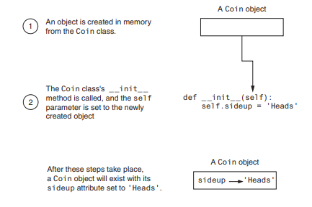
import random
class Coin:
def __init__(self):
self.sideup = 'Heads'
def toss(self):
if random.randint(0, 1) == 0:
self.sideup = 'Heads'
else:
self.sideup = 'Tails'
def get_sideup(self):
return self.sideup
def main():
my_coin = Coin()
print('This side is up:', my_coin.get_sideup())
print('I am tossing the coin ...')
my_coin.toss()
print('This side is up:', my_coin.get_sideup())
if __name__ == '__main__':
main()

Slide 8
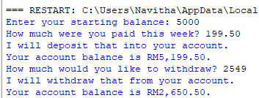
class BankAccount:
def __init__(self, balance):
self.__balance = balance
def deposit(self, amount):
self.__balance += amount
def withdraw(self, amount):
if self.__balance >= amount:
self.__balance -= amount
else:
print('Error: Insufficient funds')
def get_balance(self):
return self.__balance
import bankaccount
def main():
# Get the starting balance.
start_bal = float(input('Enter your starting balance: '))
# Create a BankAccount object.
savings = bankaccount.BankAccount(start_bal)
# Deposit the user's paycheck.
pay = float(input('How much were you paid this week? '))
print('I will deposit that into your account.')
savings.deposit(pay)
# Display the balance.
print(f'Your account balance is RM{savings.get_balance():,.2f}.')
# Get the amount to withdraw.
cash = float(input('How much would you like to withdraw? '))
print('I will withdraw that from your account.')
savings.withdraw(cash)
# Display the balance.
print(f'Your account balance is RM{savings.get_balance():,.2f}.')
# Call the main function.
if __name__ == '__main__':
main()

Slide 9
Working with Instances
Each instance of a class has its own set of data attributes.
We call these attributes instance attributes because they belong to a specific instance of the class.
It is possible to create many instances of the same class in a program.
Each instance will then have its own set of attributes.

Slide 10
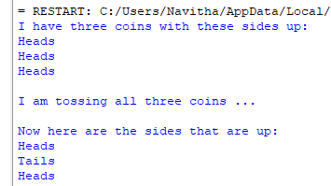
# This program imports the simulation module and
# creates three instances of the Coin class.
import coin
def main():
# Create three objects from the Coin class.
coin1 = coin.Coin()
coin2 = coin.Coin()
coin3 = coin.Coin()
# Display the side of each coin that is facing up.
print('I have three coins with these sides up:')
print(coin1.get_sideup())
print(coin2.get_sideup())
print(coin3.get_sideup())
print()
# Toss the coin.
print('I am tossing all three coins ...')
print()
coin1.toss()
coin2.toss()
coin3.toss()
# Display the side of each coin that is facing up.
print('Now here are the sides that are up:')
print(coin1.get_sideup())
print(coin2.get_sideup())
print(coin3.get_sideup())
print()
# Call the main function.
if __name__ == '__main__':
main()
import random
class Coin:
def __init__(self):
# Constructor: Initialize __sideup with 'Heads'
self.__sideup = 'Heads'
def toss(self):
# Simulate a coin toss
if random.randint(0, 1) == 0:
self.__sideup = 'Heads'
else:
self.__sideup = 'Tails'
def get_sideup(self):
# Get the current side facing up
return self.__sideup

Slide 11
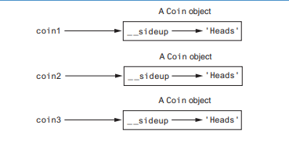

Slide 12
QUESTION
Wireless Solutions, Inc. is a business that sells cell phones and wireless service. You are a programmer in the company’s IT department, and your team is designing a program to manage all of the cell phones that are in inventory. You have been asked to design a class that represents a cell phone. The data that should be kept as attributes in the class are as
follows:
• The name of the phone’s manufacturer will be assigned to the _ _manufact attribute.
• The phone’s model number will be assigned to the _ _model attribute.
• The phone’s retail price will be assigned to the _ _retail_price attribute.
The class will also have the following methods:
• An _ _init_ _ method that accepts arguments for the manufacturer, model number,
and retail price.
• A set_manufact method that accepts an argument for the manufacturer. This method
will allow us to change the value of the _ _manufact attribute after the object has
been created, if necessary.
• A set_model method that accepts an argument for the model. This method will allow
us to change the value of the _ _model attribute after the object has been created, if
necessary.
• A set_retail_price method that accepts an argument for the retail price. This
method will allow us to change the value of the _ _retail_price attribute after the
object has been created, if necessary.
• A get_manufact method that returns the phone’s manufacturer.
• A get_model method that returns the phone’s model number.
• A get_retail_price method that returns the phone’s retail price.

